Slide 1
Dimensionality Reduction
Shoaib Jameel
Lab: 27 October 2023

Slide 2
Goal
We will try dimensionality reduction on the computer today
We will replicate the examples in this [Landauer_Foltz_Laham_1998.pdf (colorado.edu)] paper
We will create our synthetic dataset
We will create the term-document matrix
Reduce the size of the term-document matrix
We will adopt a visualization technique

Slide 3
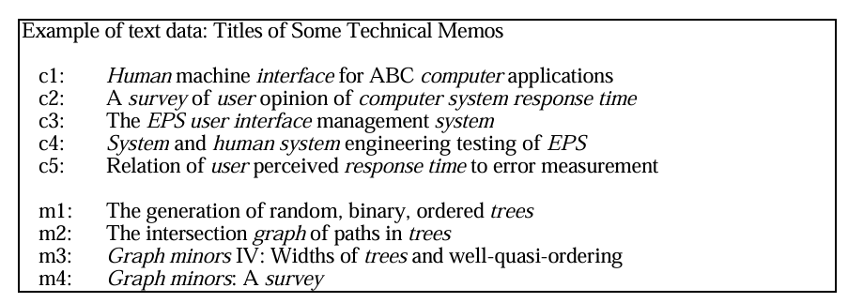
Example Synthetic Dataset

Slide 4
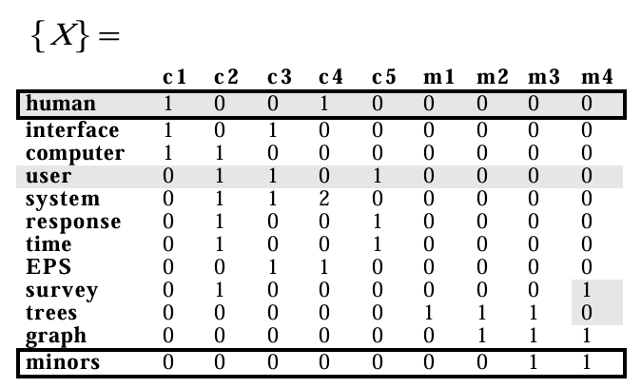
Term-Document Matrix

Slide 5
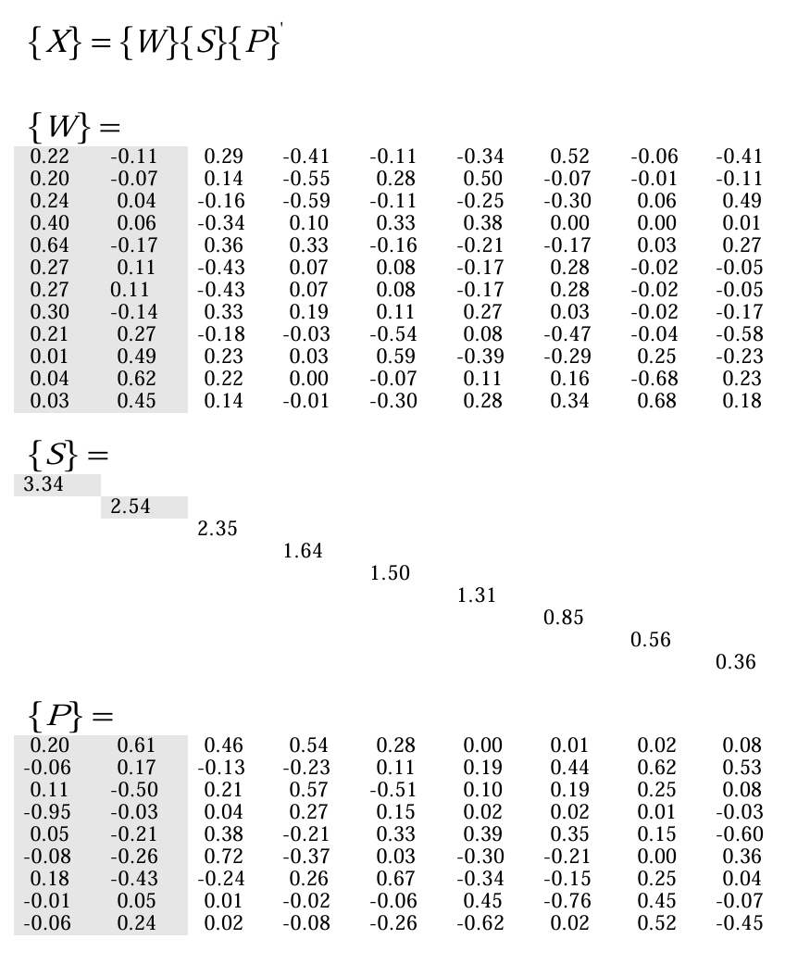

Slide 6
